Slide 1
Quadcopters

Slide 2
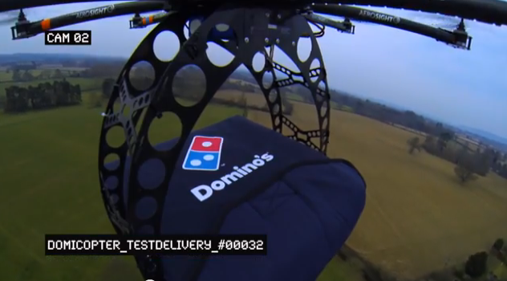
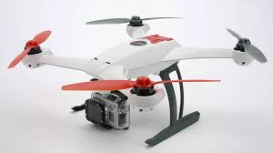
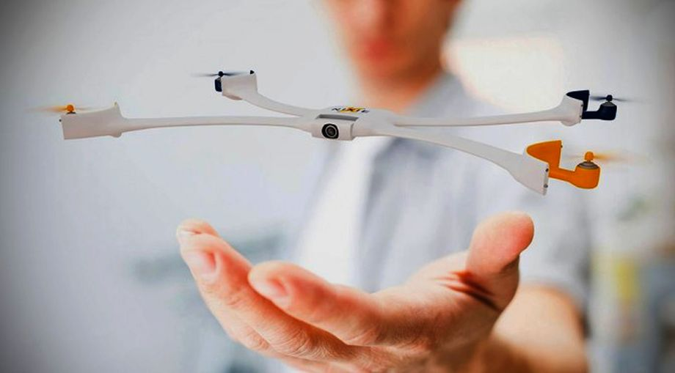
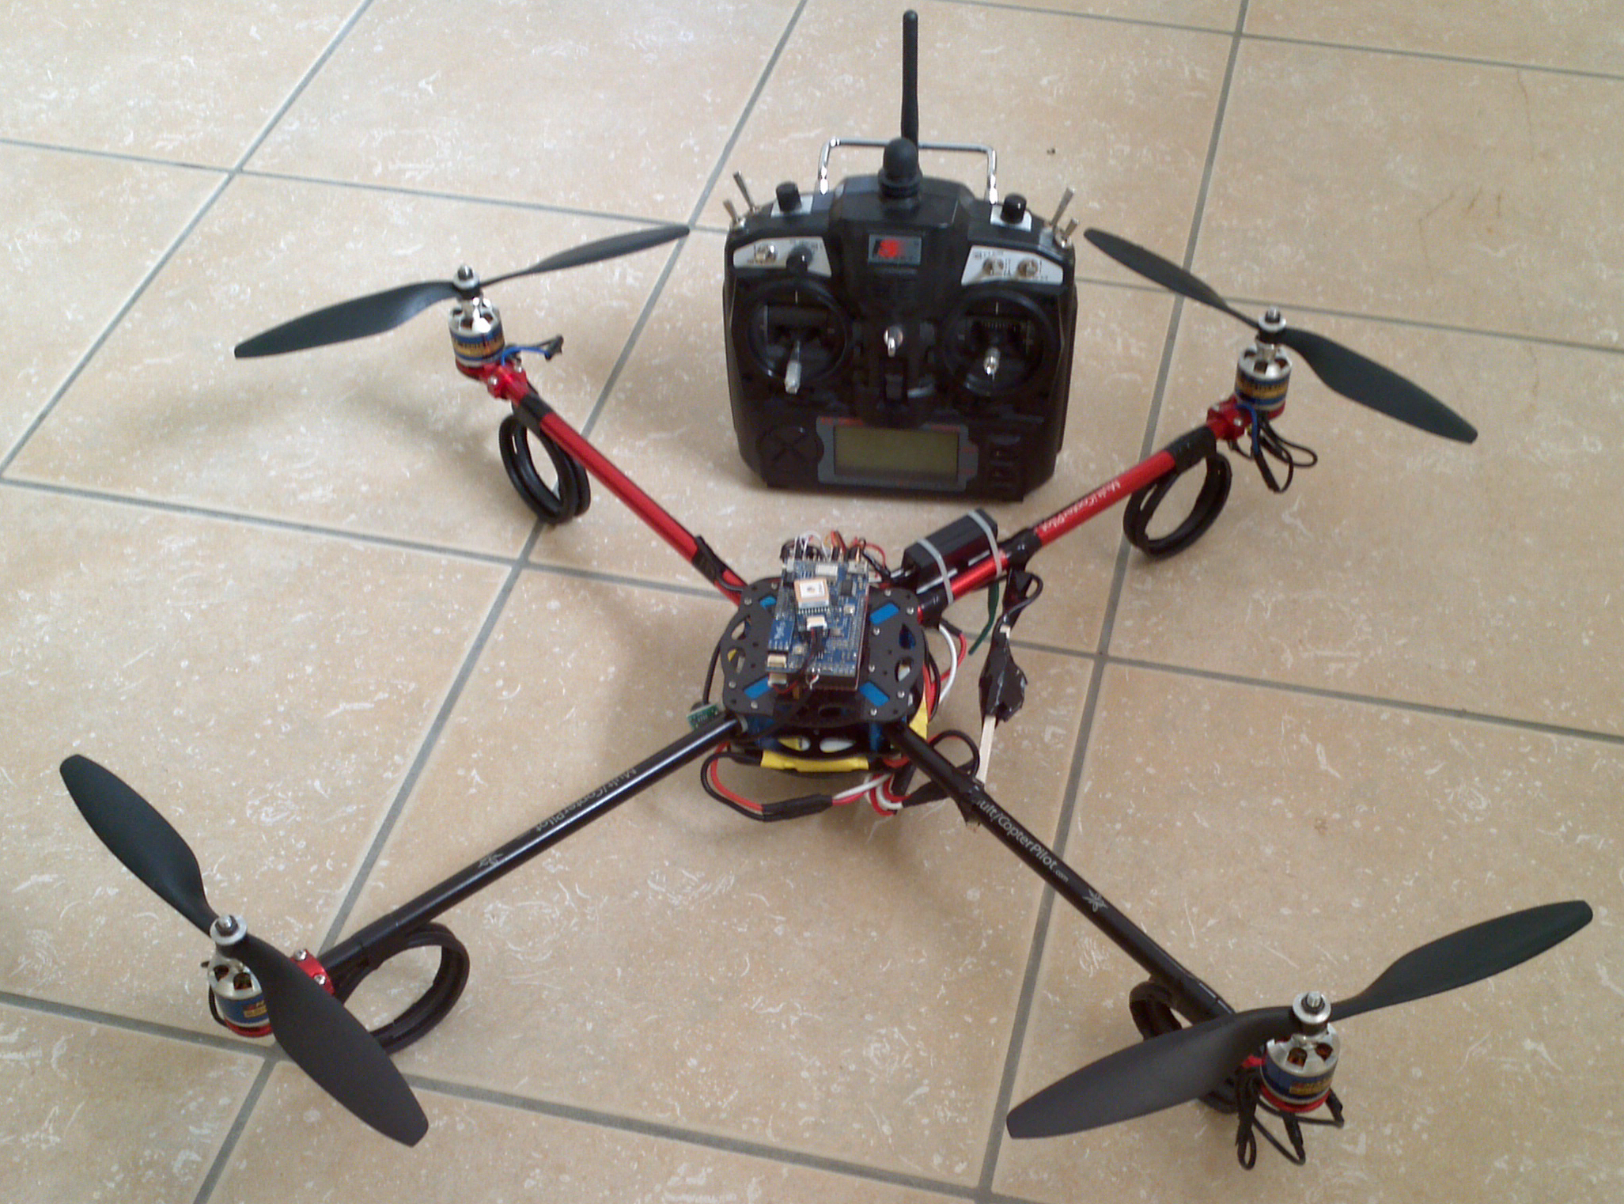
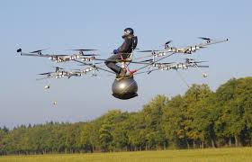
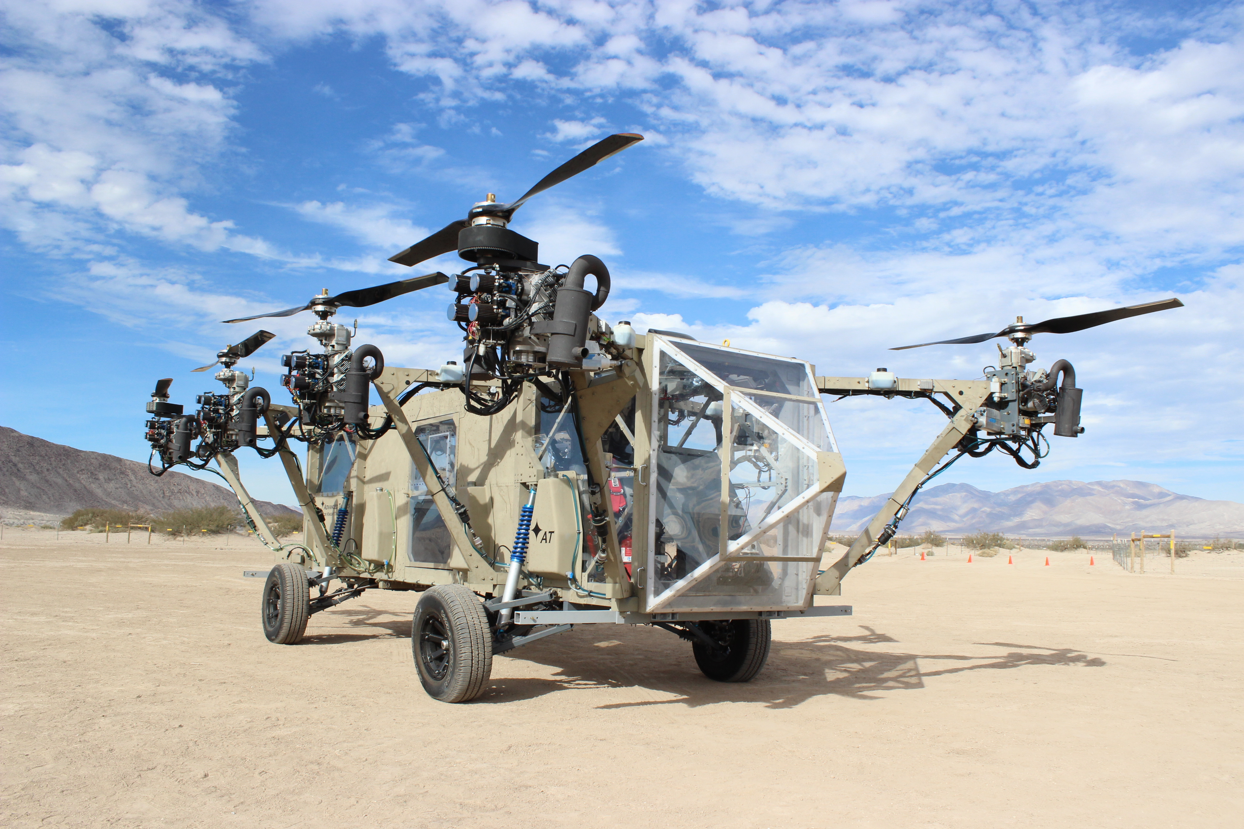
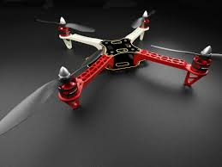
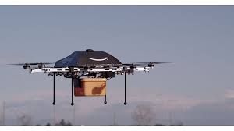
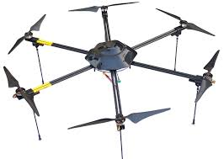

Slide 3
Multirotor Aircraft Components
Airframe
Structural support
Plastic, aluminum, wood, or PCB (fiberglass)
Motors
Lift, movement, and control
Brushed DC motors for small craft
Brushless brushless DC motors for large craft.
Inertial Measurement Unit (IMU)
Sensing the aircraft’s orientation and movement
Gyroscopes and accelerometers.
Computing resources (microcontroller/processor)
To run the flight control software
Manage communication
Flight control software
Provides stability using the IMU and motors
Converts pilot commands to motor outputs
Radio
For receiving command
Returning telemetry.
Power supply
Lots of power for the motors
Carefully regulated power for the IMU and micro controller.

Slide 4
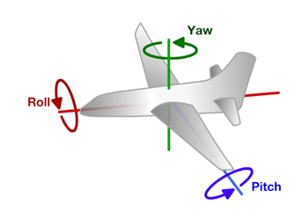
Principles of Operation (1)
An even number of motors provides lift and control in 6 dimensions
Spatial dimensions: x, y, z
Pitch: rotation around left-right (y) axis
Roll: rotation around the front-back (x) axis
Yaw: rotation around the top-bottom (z) axis
A flight computer operates a closed-loop controller to maintain stability and implement pilot commands.
Z
X
Y

Slide 5
Controlling Pitch
Pitch forward
More thrust to the rear
Less to the front
Pitch backward
Less thrust to the rear
More to the back

Slide 6
Controlling Roll
Pitch Left
More thrust to the right motor
Less to the left
Pitch Right
More thrust to the left motor
Less to the Right

Slide 7
Controlling Yaw
Rotate CCW
More thrust to the CCW motors
Less to the CW
Rotate CW
More thrust CW motors
Less to the CCW

Slide 8
Some Possible Configurations
Hexa +
Hexa x
“Plus”
“X”
Octa +
Octa x
“Octothorpe”
Y 6

Slide 9
Maintaining Stability
Multi-rotor aircraft are inherently unstable
Mismatched motor power (voltage variation, manufacturing variation in motors or props)
Variation in air currents and density.
Once perturbed, there’s no force acting on the aircraft to return it to equilibrium.

Slide 10
Maintaining Stability
Multi-rotor aircraft require a closed loop controller
Sensors detect aircraft movement and orientation
Controller adjusts the power to motors to maintain desired location and orientation
Multi-rotor aircraft use a few sensors to maintain stability
Accelerometers (absolute pitch and roll)
Gyroscopes (changes in pitch, roll, and yaw)
The flight computer implements the control algorithm
Usually a proportional, integral, derivative (PID) controller implemented in software.
We will talk more about this later.
With PID controllers for pitch, yaw, and roll multirotor aircraft can achieve stable flight.

Slide 11
Higher-order Navigation
Large multi-rotor aircraft can do more
Maintain geographic position
Maintain altitude
Follow an prescribed/pre-programmed path
More sensors required
Magnetometers (absolute yaw or heading)
GPS (absolute location and altitude)
Barometers (altitude)

Slide 12
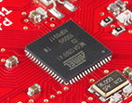
Flight Computer
ATmega128RFA1 microcontroller
Arduino compatible
16Mhz clock
128KB Flash
16KB SRAM
4096B EEPROM
2.4GHz radio (Compatible with Zigbee)

Slide 13
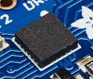
Inertial Measurement Unit
STMicro LSM9DS0
9-axis sensor
3-axis accelerometer
3-axis magnetometer
3-axis gyroscope
I2C interface (more on this later)

Slide 14
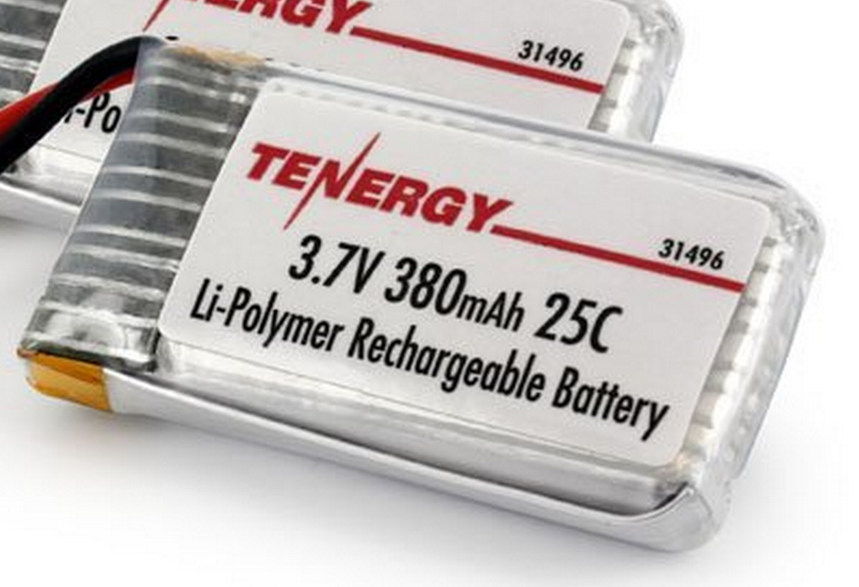
Power Supply
Lithium Polymer Battery
370 Mah
Max 9.25 Amps
Nominal voltage = 3.7V
Powers the motors directly
3.0V low dropout (LDO) voltage regulator
Powers the microcontroller and the IMU
Why 2.7 or 3V instead of 3.3V?

Slide 15
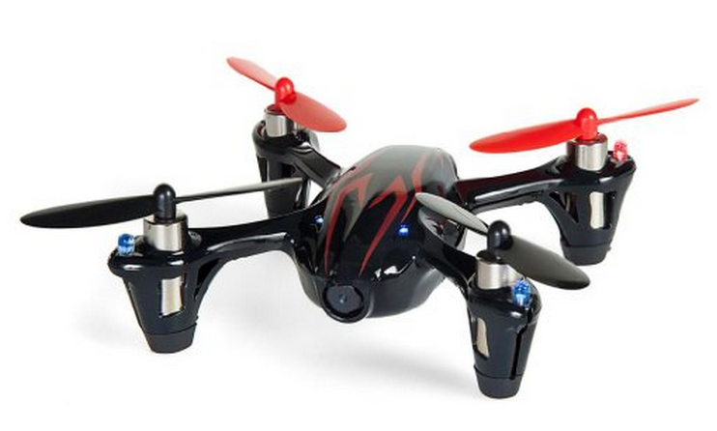
Motors and Props
Suitable motors are hard to find in small quantities.
Correct-fitting props are also a challenge
We will use motors for the Hubsan X4
Purchased as a “crash pack”
Plenty of power
DC brushed motors
They draw ~2A each.

Slide 16
Motor Driver
Pulse-width modulation (PWM)-controlled MOSFET
The microcontroller will drive the MOSFET
The MOSFET will drive current to the motor.
A diode handles the inductive load from motor when it’s off.

Slide 17
Wireless Communication
We will use a custom (i.e., designed by you) communication protocol between the controller an the quadcopter.
Why not one of the existing alternatives?
Standard RC radio protocols are analog or closed source.
Zigbee is complex and closed source.

Slide 18
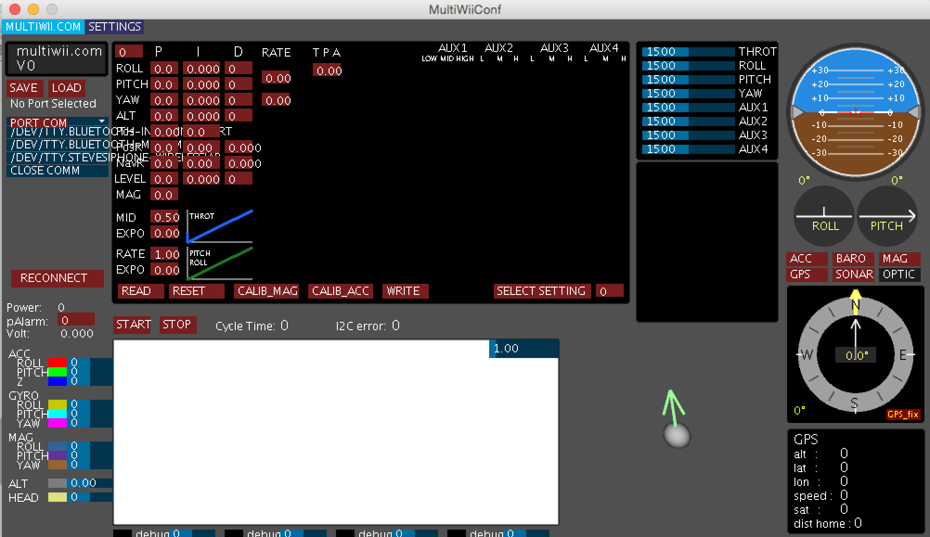
Flight Control Software (Option 1)
Use the MultiWii flight controller software
Open source
Arduino-compatible
Widely used
A GUI
(but not with out it’s idiosyncracies)
You’ll implement the PID controller.

Slide 19
Flight Control Software (Option 2)
Write it from scratch
We will still use the GUI

Slide 20
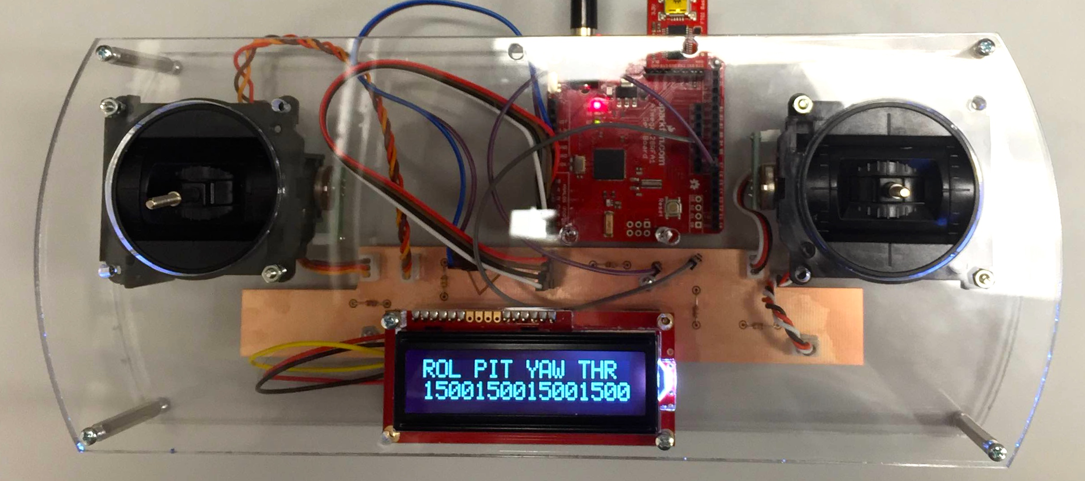
Controller
The controller sends commands to the quadcopter via the radio.
We have a controller design ready for you
It uses the same microcontroller we are using
You’ll be able to customize it a bit.

Slide 21

What You Will Build

Slide 22
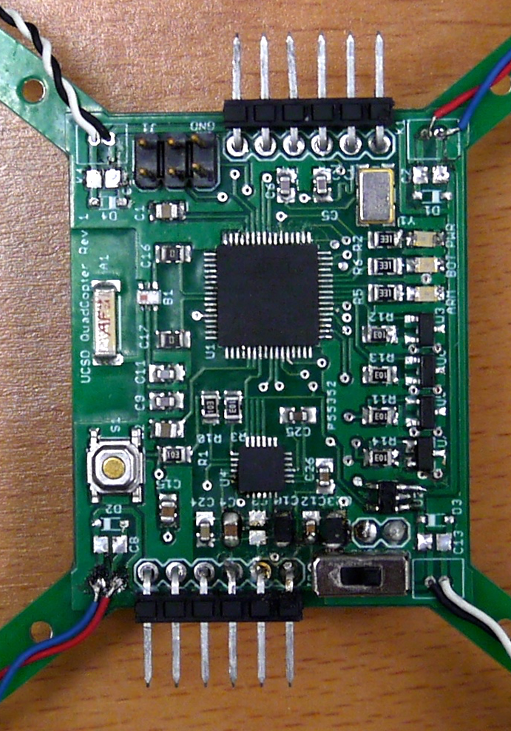
What You Will Build

